Slide 1
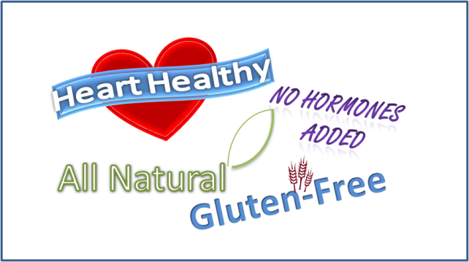
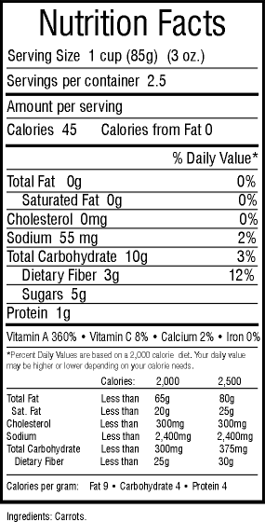
Food Labels
When reading package labels, consider these things…
Is this term regulated?
Even if the term is regulated, does it apply to my nutrition needs?
Can the nutrition facts or ingredients tell me more information?
REGULATED TERMS
Organic
Cage-Free
Free-Range
Natural (meat, poultry, eggs)
Grass-fed
Gluten-free
NON-REGULATED TERMS
Humanely-raised
Natural (besides meat, poultry, eggs)
No added hormones
Pasture-raised
For example, the recently regulated term “gluten-free” IS important for people with Celiac disease, but it does not mean a product is “healthier” for everyone.
No single food can meet all your nutrition needs, so looking at the same nutrients on every label won’t give you all the info. Below are just a few things to consider when looking at the nutrition facts.
LABEL INFO | TIPS
Servings/ Calories | Check the serving size and number of servings. Note the calories are per serving.
Saturated Fat | Check fat when choosing meats, dairy products, and pre-made foods (granola, frozen dinners, etc). Aim for <10% daily value from saturated fat
Sodium | Monitor sodium in packaged foods (soups, frozen dinners, crackers, etc) Think of daily meal plan: if having three meals, each one should be under roughly 800 mg sodium (for total intake <2300 mg)
Total Carb | People with diabetes should check total carbs for blood sugar purposes.
Fiber | Aim for >3 g fiber per serving in packaged goods (bread, cereal, crackers)
Sugar | This line indicates both natural and added sugars. Check the ingredients to assess added sugar.
Ingredients | Aim for simple ingredients. If sugar from any source is one of top three ingredients, consume this food in moderation.

